Slide 1
Chapter Four Characterizing Network Traffic

Slide 2
Network Traffic Factors
Traffic flow
Location of traffic sources and data stores
Traffic load
Traffic behavior
Quality of Service (QoS) requirements

Slide 3
Traffic Flow Example
30 Library Patrons (PCs)
30 Macs and 60 PCs in Computing Center
10-Mbps Metro Ethernet to Internet
Server Farm
App 1 108 Kbps
App 2 60 Kbps
App 3 192 Kbps
App 4 48 Kbps
App 7 400 Kbps
Total 808 Kbps
App 2 20 Kbps
App 3 96 Kbps
App 4 24 Kbps
App 9 80 Kbps
Total 220 Kbps
50 PCs
25 Macs
50 PCs
Administration
Arts and Humanities
App 1 30 Kbps
App 2 20 Kbps
App 3 60 Kbps
App 4 16 Kbps
Total 126 Kbps
App 1 48 Kbps
App 2 32 Kbps
App 3 96 Kbps
App 4 24 Kbps
App 5 300 Kbps
App 6 200 Kbps
App 8 1200 Kbps
Total 1900 Kbps
Math and Sciences
30 PCs
50 PCs
Business and Social Sciences

Slide 4
Types of Traffic Flow
Terminal/host
Client/server
Thin client
Peer-to-peer
Server/server
Distributed computing

Slide 5
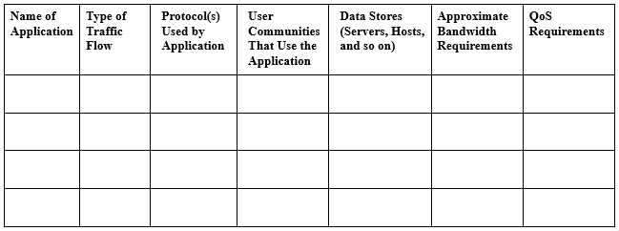
Network Applications Traffic Characteristics

Slide 6
Traffic Load
To calculate whether capacity is sufficient, you should know:
The number of stations
The average time that a station is idle between sending frames
The time required to transmit a message once medium access is gained
That level of detailed information can be hard to gather, however

Slide 7
Size of Objects on Networks
Terminal screen: 4 Kbytes
Simple e-mail: 10 Kbytes
Simple web page: 50 Kbytes
High-quality image: 50,000 Kbytes
Database backup: 1,000,000 Kbytes or more

Slide 8
Traffic Behavior
Broadcasts
All ones data-link layer destination address
FF: FF: FF: FF: FF: FF
Doesn’t necessarily use huge amounts of bandwidth
But does disturb every CPU in the broadcast domain
Multicasts
First bit sent is a one
01:00:0C:CC:CC:CC (Cisco Discovery Protocol)
Should just disturb NICs that have registered to receive it
Requires multicast routing protocol on internetworks

Slide 9
Network Efficiency
Frame size
Protocol interaction
Windowing and flow control
Error-recovery mechanisms

Slide 10
QoS Requirements
ATM service specifications
Constant bit rate (CBR)
Realtime variable bit rate (rt-VBR)
Non-realtime variable bit rate (nrt-VBR)
Unspecified bit rate (UBR)
Available bit rate (ABR)
Guaranteed frame rate (GFR)

Slide 11
QoS Requirements per IETF
IETF integrated services working group specifications
Controlled load service
Provides client data flow with a QoS closely approximating the QoS that same flow would receive on an unloaded network
Guaranteed service
Provides firm (mathematically provable) bounds on end-to-end packet-queuing delays

Slide 12
QoS Requirements per IETF
IETF differentiated services working group specifications
RFC 2475
IP packets can be marked with a differentiated services codepoint (DSCP) to influence queuing and packet-dropping decisions for IP datagrams on an output interface of a router

Slide 13
Summary
Continue to use a systematic, top-down approach
Don’t select products until you understand network traffic in terms of:
Flow
Load
Behavior
QoS requirements

Slide 14
Review Questions
List and describe six different types of traffic flows.
What makes traffic flow in voice over IP networks challenging to characterize and plan for?
Why should you be concerned about broadcast traffic?
How do ATM and IETF specifications for QoS differ?

